Slide 1
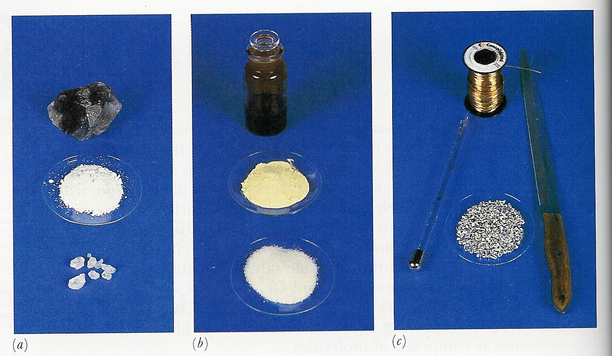
Chemical Bonding

Slide 2
Chemical Forces Hold Atoms Together in Molecules
Three types of chemical forces
Ionic Bonds – electrons exchanged to form ions
Covalent Bonds – electrons shared
Metallic Bonds – free electrons

Slide 3
Electron-dot Symbols
Also known as Lewis symbols
Show the valence electrons as dots around the symbol
Atoms gain, lose or share electrons in an attempt to achieve the same number of electrons as the noble gas closest to them

Slide 4
Octet Rule
Since all noble gases (except He) have 8 valence electrons, atoms undergo reaction to end up with 8 valence electrons

Slide 5
What Are Dot Symbols For Each
Li
Ni
Si
O
Na
Cl
Ne
H
He

Slide 6
Electronegativity
Electronegativity is a numerical value that describes an atom’s ability to attract electrons to itself
Ranges from .7 to 4.0 (pg. 357)
Highest for elements on top right of the periodic table

Slide 7
Bond Spectrum
There is no clear dividing line between ionic and covalent bonds
Polar covalent bond – electrons are shared but not equally (somewhat ionic in character)
Non-Polar covalent bond – electrons are shared equally

Slide 8
Electronegativity Difference
Greater the difference in electronegativity, the more ionic in character the bond
Very different electroneg → ionic
Intermediate difference → polar covalent
No difference → non-polar covalent

Slide 9
Example
Order the following bonds according to increasing polarity
H-H, O-H, Cl-H, S-H, F-H

Slide 10
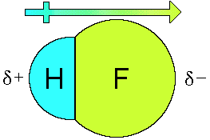
Dipole Moments (μ)
Polar molecules which have a center of positive and negative charge are said to have a dipole moment
Greater difference in electronegativity, greater dipole moment
The dipolar character is shown with an arrow pointing to the negative charge

Slide 11
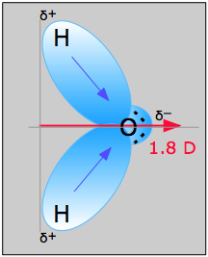
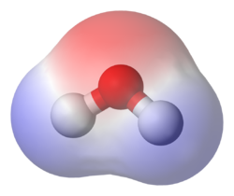
Water

Slide 12
Symmetry
Some molecules have polar bonds but no dipole moment
Occurs when bonds are arranged in a way that cancel each other out
- happens in symmetrical molecules

Slide 13
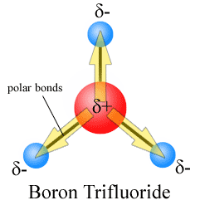

Slide 14
Bent: 2 bonded and 1 or 2 lone pair/sBent:

Slide 15
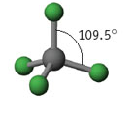
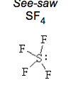
VSEPR model- four bonded pairs

Slide 16
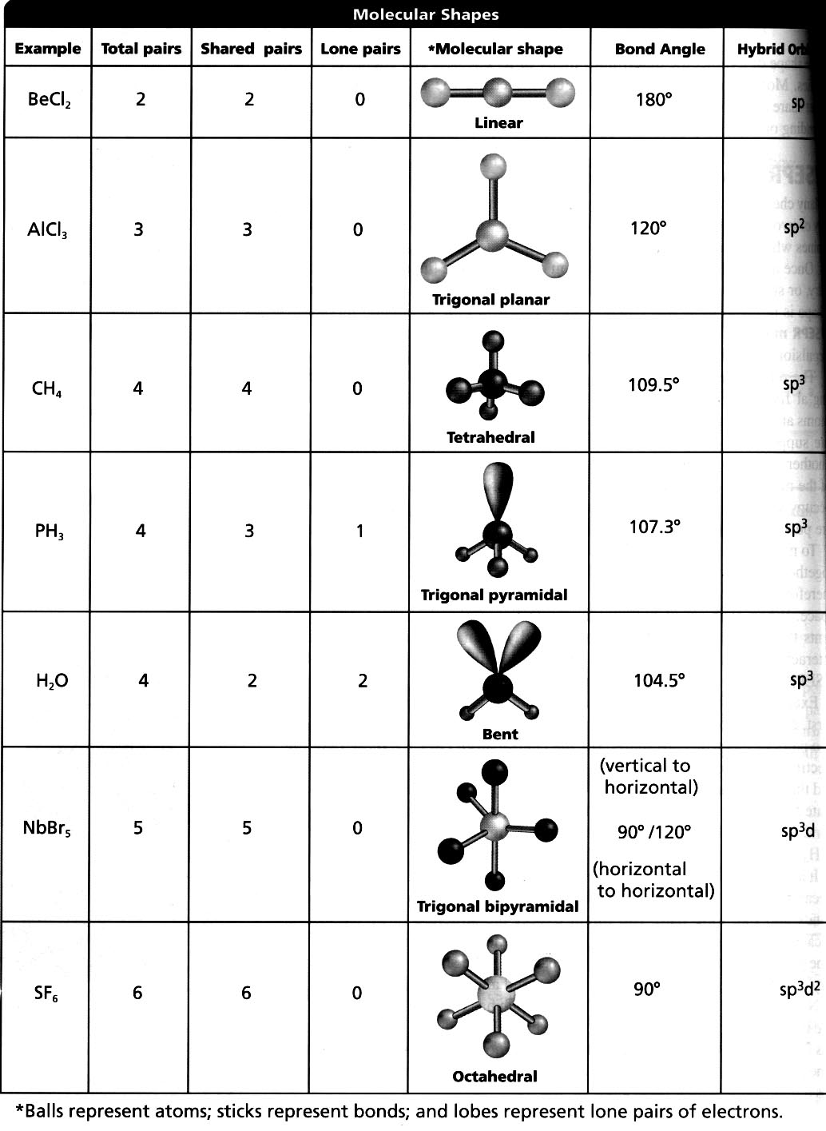

Slide 17
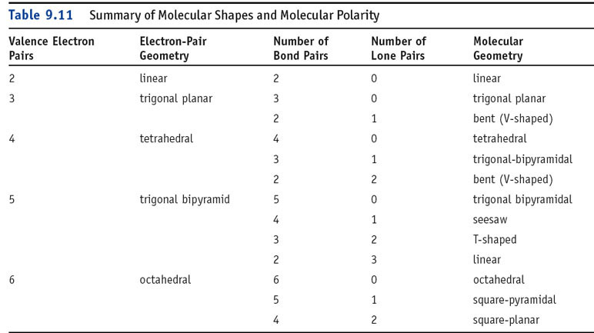

Slide 19
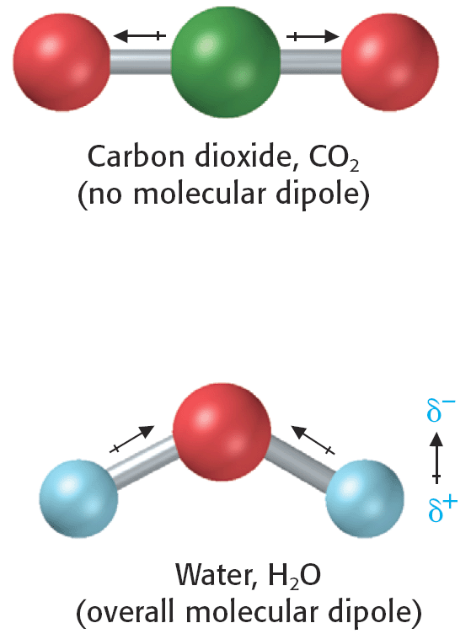

Slide 22
Properties of Molecules with a Dipole
They will align themselves in an electric or magnetic field
They will attract one another to form intermolecular forces

